Slide 1
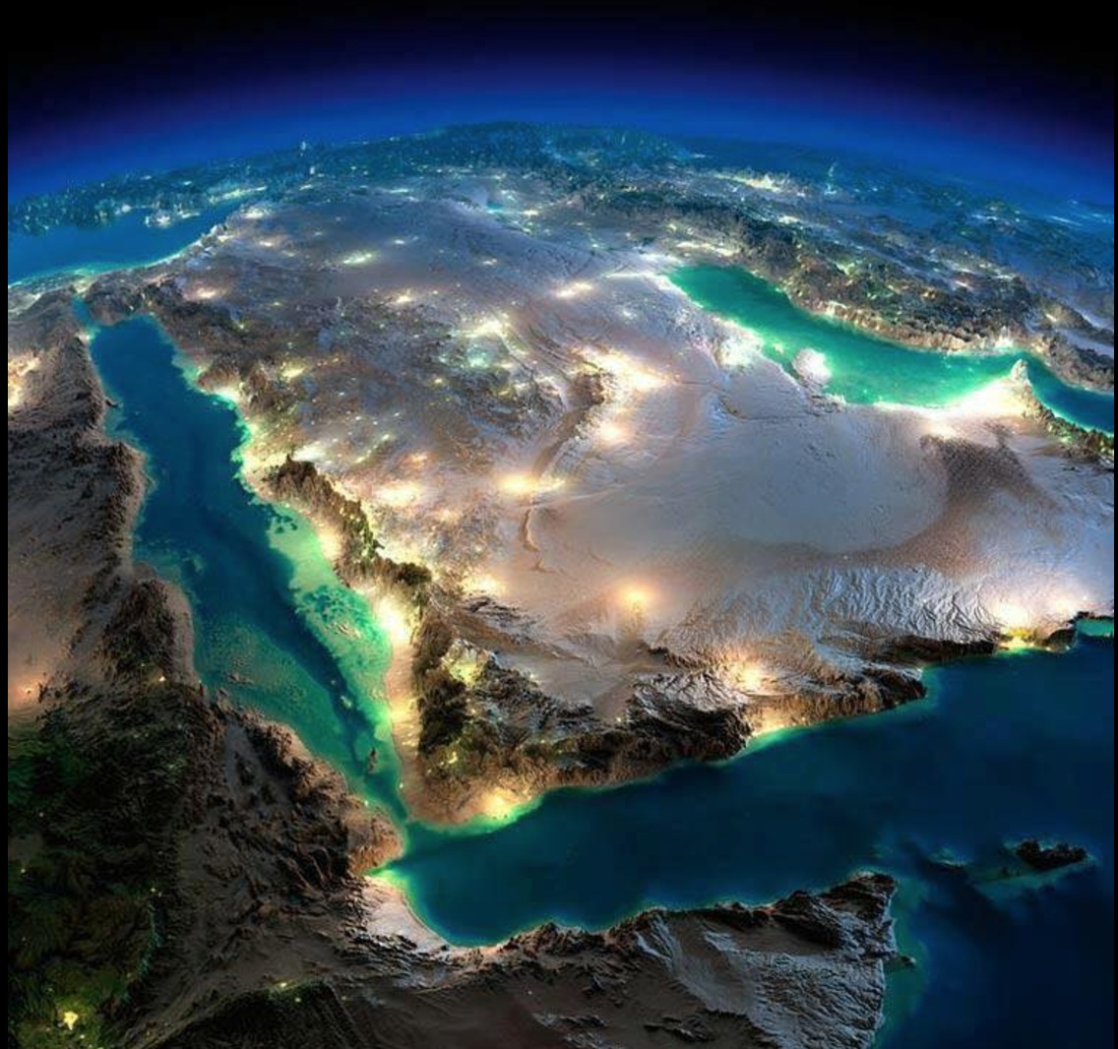
ARABIAN PENINSULA
TEAM 6
Ayara Pontioso | Francisco Coelho | Shreyak Vashisht |Tanai Torres | Jinjie Gao | Jundi Ren
Notes:
Ayara
Hello! It’s us, it’s Team 6!

Slide 2
AGENDA
Overview
Insights
Missing Values Strategy
Category Analysis
Socio – Economic
Healthcare
5. Conclusions
Notes:
For today’s agenda..
First, I’m gonna talk to you about the overview of what we found out about the data

Slide 3
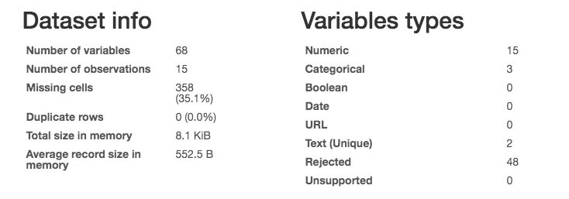
OVERVIEW
Notes:
For the overview of our collected data, we were provided 68 variables. 15 countries to observe. While we have 358 missing values, which covers 35.1% of our entire data set.

Slide 4
Overview
1. Big amount of missing values comes from:
Health, Education, Poverty
2. Some columns are replications of other columns
3. We could find relatively high correlation between some variables.
Population & GDP
Rural Population and prevalence of undernourishment
Notes:
3. Drop data: missing columns, we dropped data because the information we found in the World Bank is from different time between 2000 and 2018. Not comparable or inconsistent with our 2017 data and we still have a lot more to analyze from.
Missing Columns
Educational Attainment: Much political control exists over schools.
- https://fas.org/irp/agency/army/arabculture.pdf
Employment Rate
GINI index
Income Share
Literacy Rate
Poverty Rate
Missing Values
Tax Revenue;
Prevalence of HIV;
Military Experience;
Educational Attainment
(We don’t need to mention all of them; just categories)

Slide 5
MISSING VALUES STRATEGY
Use Mean
Use World Bank Data
Drop Data
Notes:
If data was significant (common sense), we use the mean
Otherwise we dropped it, why? Because we didn’t wanted to influence other findings
If its only one or two value we looked into the WBD
Garbage in – Garbage out: if the date you bad data, your findings will be misleading you
Syria example: we had to drop Syria.
No data available due to the war situation;
Couldn’t use the average because countries like UAE and Turkey were really high. Means that the average is too high for a country like Syria.

Slide 6
CATEGORY ANALYSIS
Socio
Economic
Healthcare
USD GDP
Population Density
Surface Area
Population Total
Merchandising Trade
Industry Value added to GDP
Urban population growth
Rural population
Prevalence of undernourishment
Adolescent Fertility Rate
Birth Rate
Death Rate
Prevalence of HIV
Life Expectancy At Birth
Notes:
We categorized the indicators broadly

Slide 7
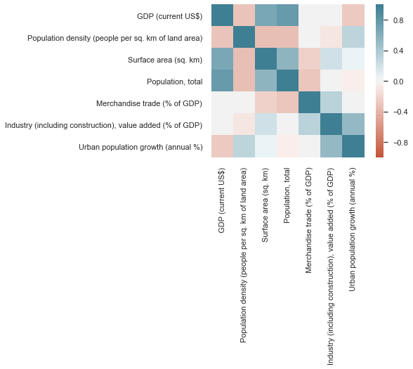
SOCIO-ECONOMIC
Notes:
We found out that surface area and population total are positively correlated, however our strongest finding was the GDP and total population correlation.
We found a possible reason for this correlation. According to PWC companies are shifting operations to a more regional level.
This phenomenon is called internationalization and according to a framework designed by the consulting firm, one of the key factors is Market Potential.
Therefore, in a more populated area or simply a bigger area, there’s a bigger potential market where companies operate and create more money, boosting the GDP.

Slide 8
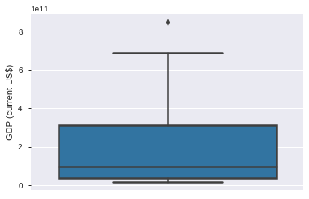
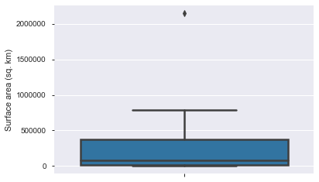
SOCIO-ECONOMIC FINDINGS
Turkey
Saudi Arabia
Notes:
To support our findings:
Turkey is a (mostly) Asian country and due to its strategic location, as well as their main industries performance’s (manufacturing, agriculture and tourism industries) the country’s GDP peaked in 2017.
In 2017 the benchmark index of Turkey's stock market, set a new record high.
Turkish companies’ foreign direct investment outflow has increased by 10 times over the past 15 years.
Renewable energy goals for 2023 were surpassed in 2017, indicating that the country is performing quite well in this sector.
These explains why it’s so far on the 4th quartile.
Saudi Arabia is the country from the Arabian peninsula with widest land mass.
However Saudi Arabia is a considerably big country in surface less than 1% of its area its habitable and its only been established as a country in 1932.
We then realized that Turkey and Saudi Arabia were amongst the countries with more population as well as GDP.
Therefore we dug deeper and we found… (next slide)

Slide 9
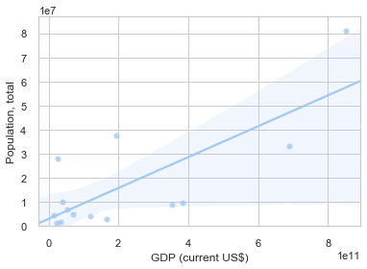
SOCIO-ECONOMIC FINDINGS
Notes:
Regression analysis demonstrated some positive correlation (upward trend line) between population and GDP among the countries from the Arabian Peninsula which supports our findings.
To be clear, correlation is not super strong but it’s definitely a positive one. After further research we came to the conclusion that 5 out of 10 from the top 10 most populated countries in the world, were also the biggest economies (in terms of GDP) in 2017.
Japan
Brazil
India
US
China

Slide 10
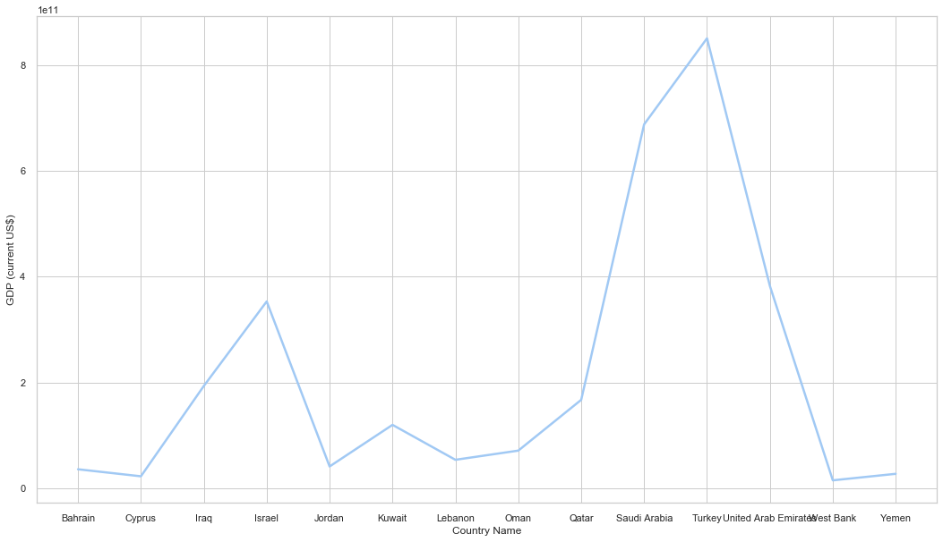
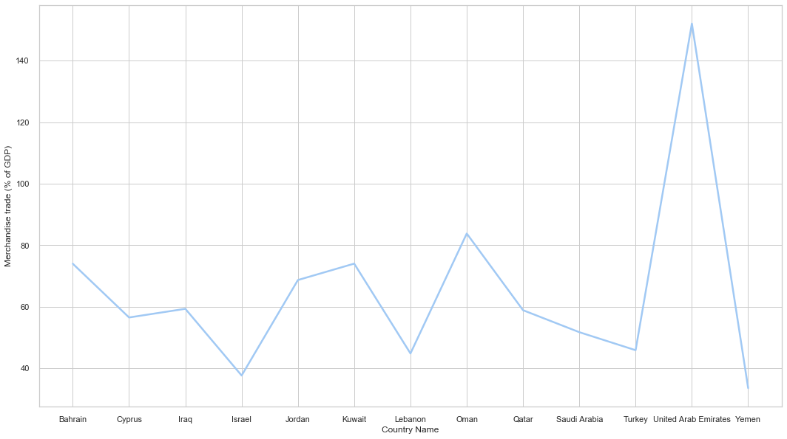
SOCIO-ECONOMIC FINDINGS
GDP (current US$)
Merchandise Trade (% of GDP)
Turkey
UAE
Notes:
Surprisingly, even though UAE is leading the peninsula countries in merchandise trade, Turkey has the highest GDP.
There’s a significant difference between UAE and the other countries from the Arabian Peninsula, in terms of Merchandise Trade.
UAE main merchandise trade are oil and natural gas, goods with a relatively high market value and with huge demand, which explains why merchandise trade as % of the GDP for that country is so above the average.
However in the recent past oil prices have been decreasing, reason why UAE’s GDP might not be as big as the one from Turkey.

Slide 11
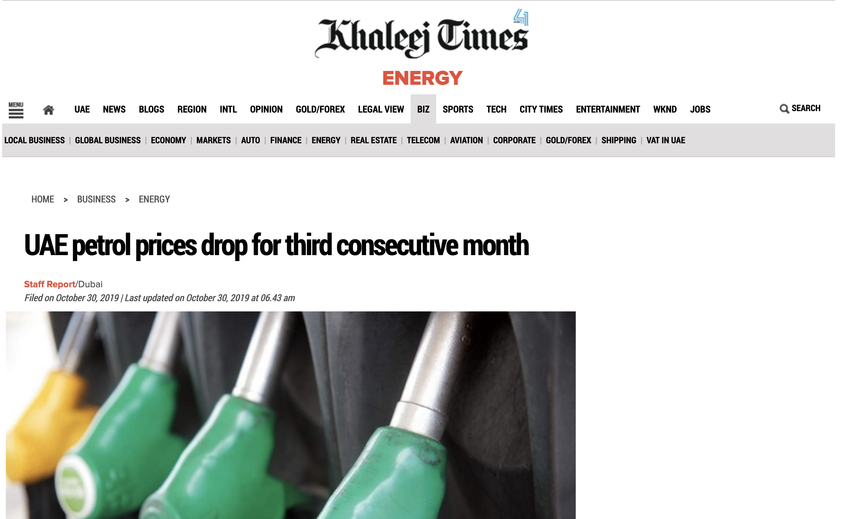
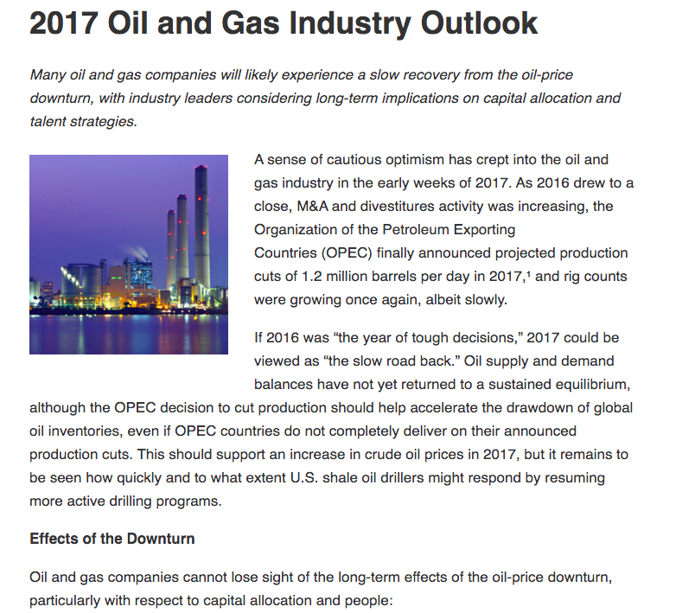
SOCIO-ECONOMIC NEWS
Notes:
Reports show that in 2017, UAE’s oil prices keep dropping. Reason for this is that the oil industry has been having a slow but steady growth. Factors to consider for this slow growth is because of hybrid engines becoming more popular, as well as electric vehicles. While carbon levels of oil and gas in these countries are dreadful, their biggest competitors, the United States and Russia, introduced natural gas to the market.

Slide 12
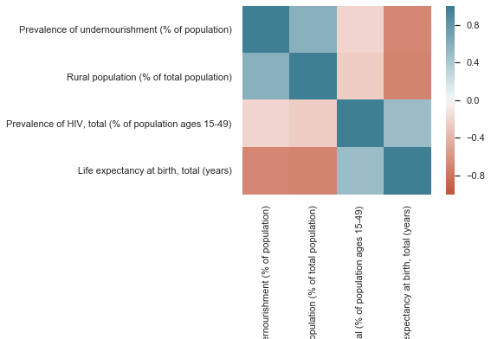
HEALTHCARE
Notes:
For the second category, we found a strong correlation between Rural population and prevalence of undernourishment. So in the next slide we are gonna go deeper on these two variables.

Slide 13
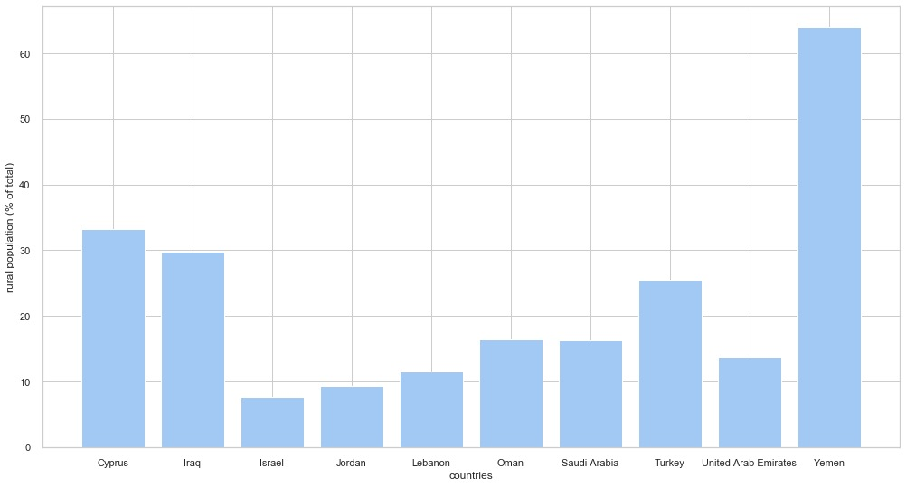
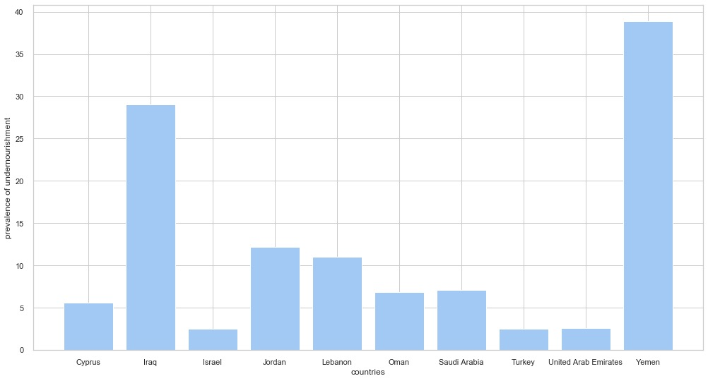
HEALTHCARE FINDINGS
Rural Population (% of total)
Prevalence of Undernourishment
Notes:
We have here a pretty interesting finding because Yemen has the highest rural population among other countries and also the undernourishment rate.
Why?
Urban areas are only 35% of the country and is not expanding because of the ongoing conflict that is happening in the country since March 2015 that civil war started.
Today twenty million Yemenis – around 70 per cent of the population – in the rural areas are food insecure and starving. This famine is being driven by economic factors caused by conflict, rather than a lack of food. Where food donations, are being snatched from the starving.
Finally, the depreciation of the Yemeni currency has caused food prices to increase, while the soaring cost of fuel has made transport more expensive and has reduce the access to food for most of the rural population in the country.

Slide 14
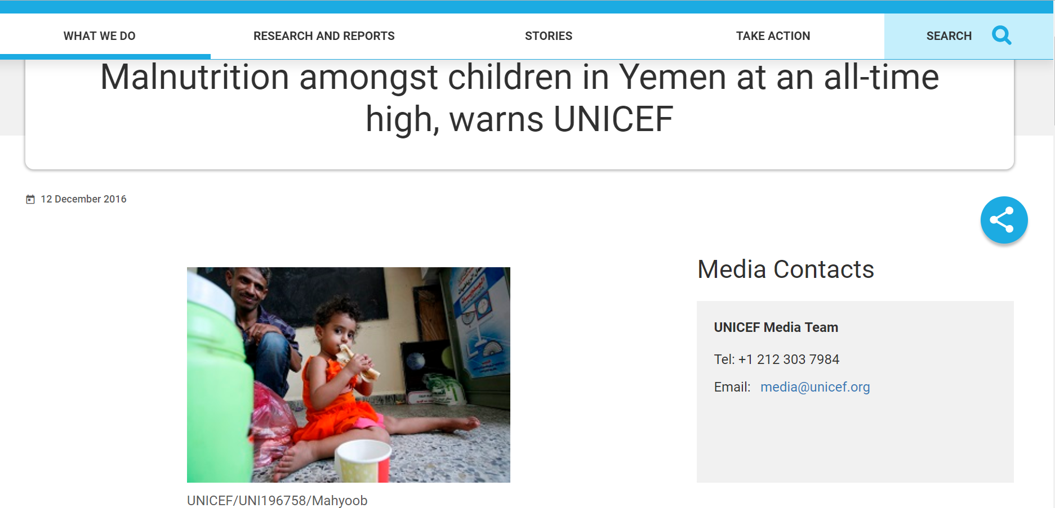
HEALTHCARE NEWS
Notes:
Side-effects of the Prevalence of Undernourishment: Children in Yemen are suffering from famine and malnutrition

Slide 15
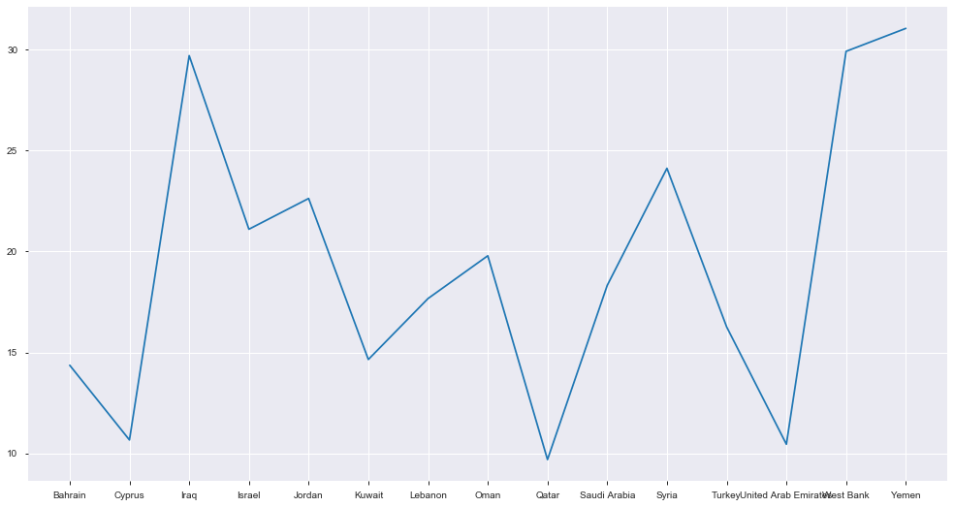
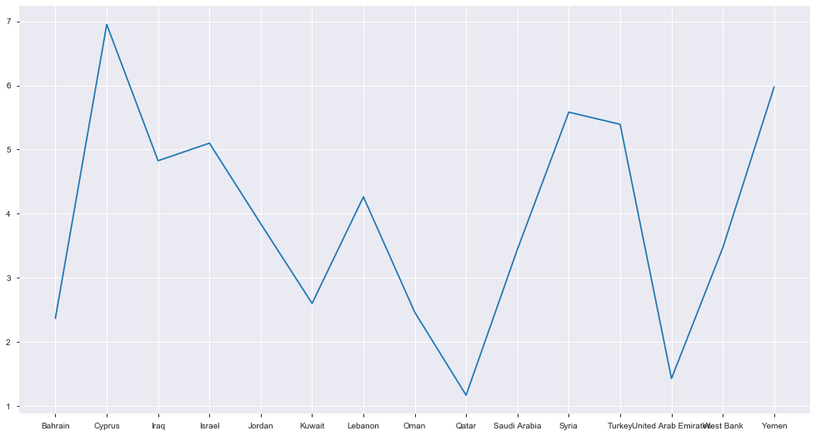
HEALTHCARE FINDINGS
Birth Rate (per 1,000 people)
Death Rate (per 1,000 people)
Yemen
Cyprus
Yemen
Cyprus

Slide 16
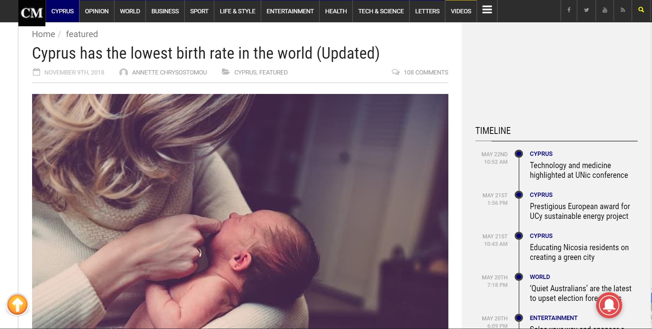
HEALTHCARE NEWS
2013 Financial Crisis
Lack of childcare
Arbitrary maternity leave
Women pursuing education and career
Notes:
According to the CyprusMail, local newspaper, the financial crisis changed people’s mentality making them wonder if they will have enough money to provide for their children in the upcoming future, or if they will be able to have a decent education and childcare system in the future. Also we found out that women would rather pursue education than having a child because they think that education is a better investment for their money and energy rather than babies.
Also, we found out that in Cyprus there is limited access to childcare which makes it difficult for new parents because babies need a lot of medical attention.
Another reason according to the article, is that their maternity leave is not as good as the rest of the world’s.
The Cyprus women only get paid 75% of their salary during their time off. According to the citizens, the 25% loss from their salary is already a big portion compared to what they have to spend from having a new child.

Slide 17
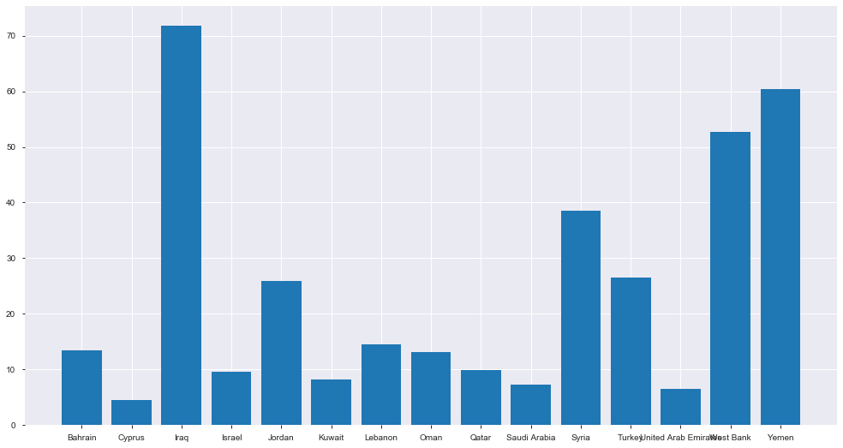
HEALTHCARE FINDINGS
Adolescent fertility rate (births per 1,000 women ages 15-19)
Notes:
As we can see, when it comes to adolescent fertility rate between women with ages 15-19, Iraq is leading. Causing the country to have a pyramid shaped age demographic.
Iraq has the most women giving birth between those ages. This is mostly due to the fact that Iraq girl get married in an early age.
In fact, 24% of Iranian girls get married even before turning 18 and therefore they also start a family earlier than most of the world standards.

Slide 18
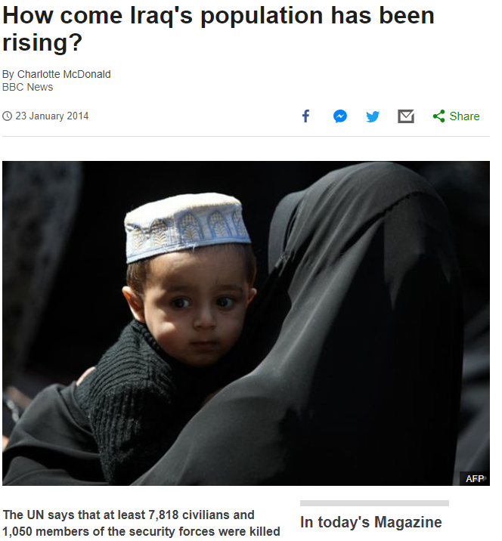
HEALTHCARE NEWS
Iraq's women have 4.2 children on average
24% of Iraqi girls get married before turning 18
Large families
Gender norms in Iraq
Notes:
Reasons behind this are:
…during post-adolescent age
This is mostly due to the fact that Iraqi girls get married in an early age.
In fact, 24% of Iraqi girls get married even before turning 18.
It is in the norm in Iraq, to have big families.
Because of the gender norms in Iraq, women have limited choices whether they’re starting a family or not.

Slide 19
HEALTHCARE FINDINGS
HIV Results
Countries | World Bank | HIV Cases | Population | New HIV | Difference
Israel | 0.2% | 7,745 | 5,338,970 | 0.15% | 0.05%
Jordan | 0.1% | 2,131 | 6,163,570 | 0.03% | 0.7%
Kuwait | 0.1% | <1000 | 3,140,660 | 0.03% | 0.7%
Lebanon | 0.1% | 1,130 | 4,582,050 | 0.02% | 0.08%
Oman | 0.2% | 1,684 | 3,639,530 | 0.05% | 0.15%
Syria | 0.1% | 640 | 10,832,760 | 0.01% | 0.09%
Yemen | 0.1% | 2,701 | 16,389.26 | 16.48% | 16.38%
Notes:
Firstly, before analyzing this table there’s a few things you should know.
Data from: Bahrain Cyprus Iraq Qatar Saudi Arabia Turkey United Arab Emirates West Bank were excluded due to the fact that either the data from the World Bank was missing so we had no terms of comparison.
The new data is all regarding the year of 2016 and it was sourced either from the World Health Organization website or the UNAIDS website.
Assumption: the HIV reported cases were from people in between ages of 15 and 49.
Assumption: the population data it’s only for people aged between 15 to 64.
According to the World’s Bank data these are the % of population with ages from 15 to 49 that have HIV.
There is a clear difference between the results from the original Data Set and the New Calculated Data especially in Yemen and Oman.
Given this we concluded that the either the HIV cases significantly increase or the countries are not being coherent on their data reporting.

Slide 20
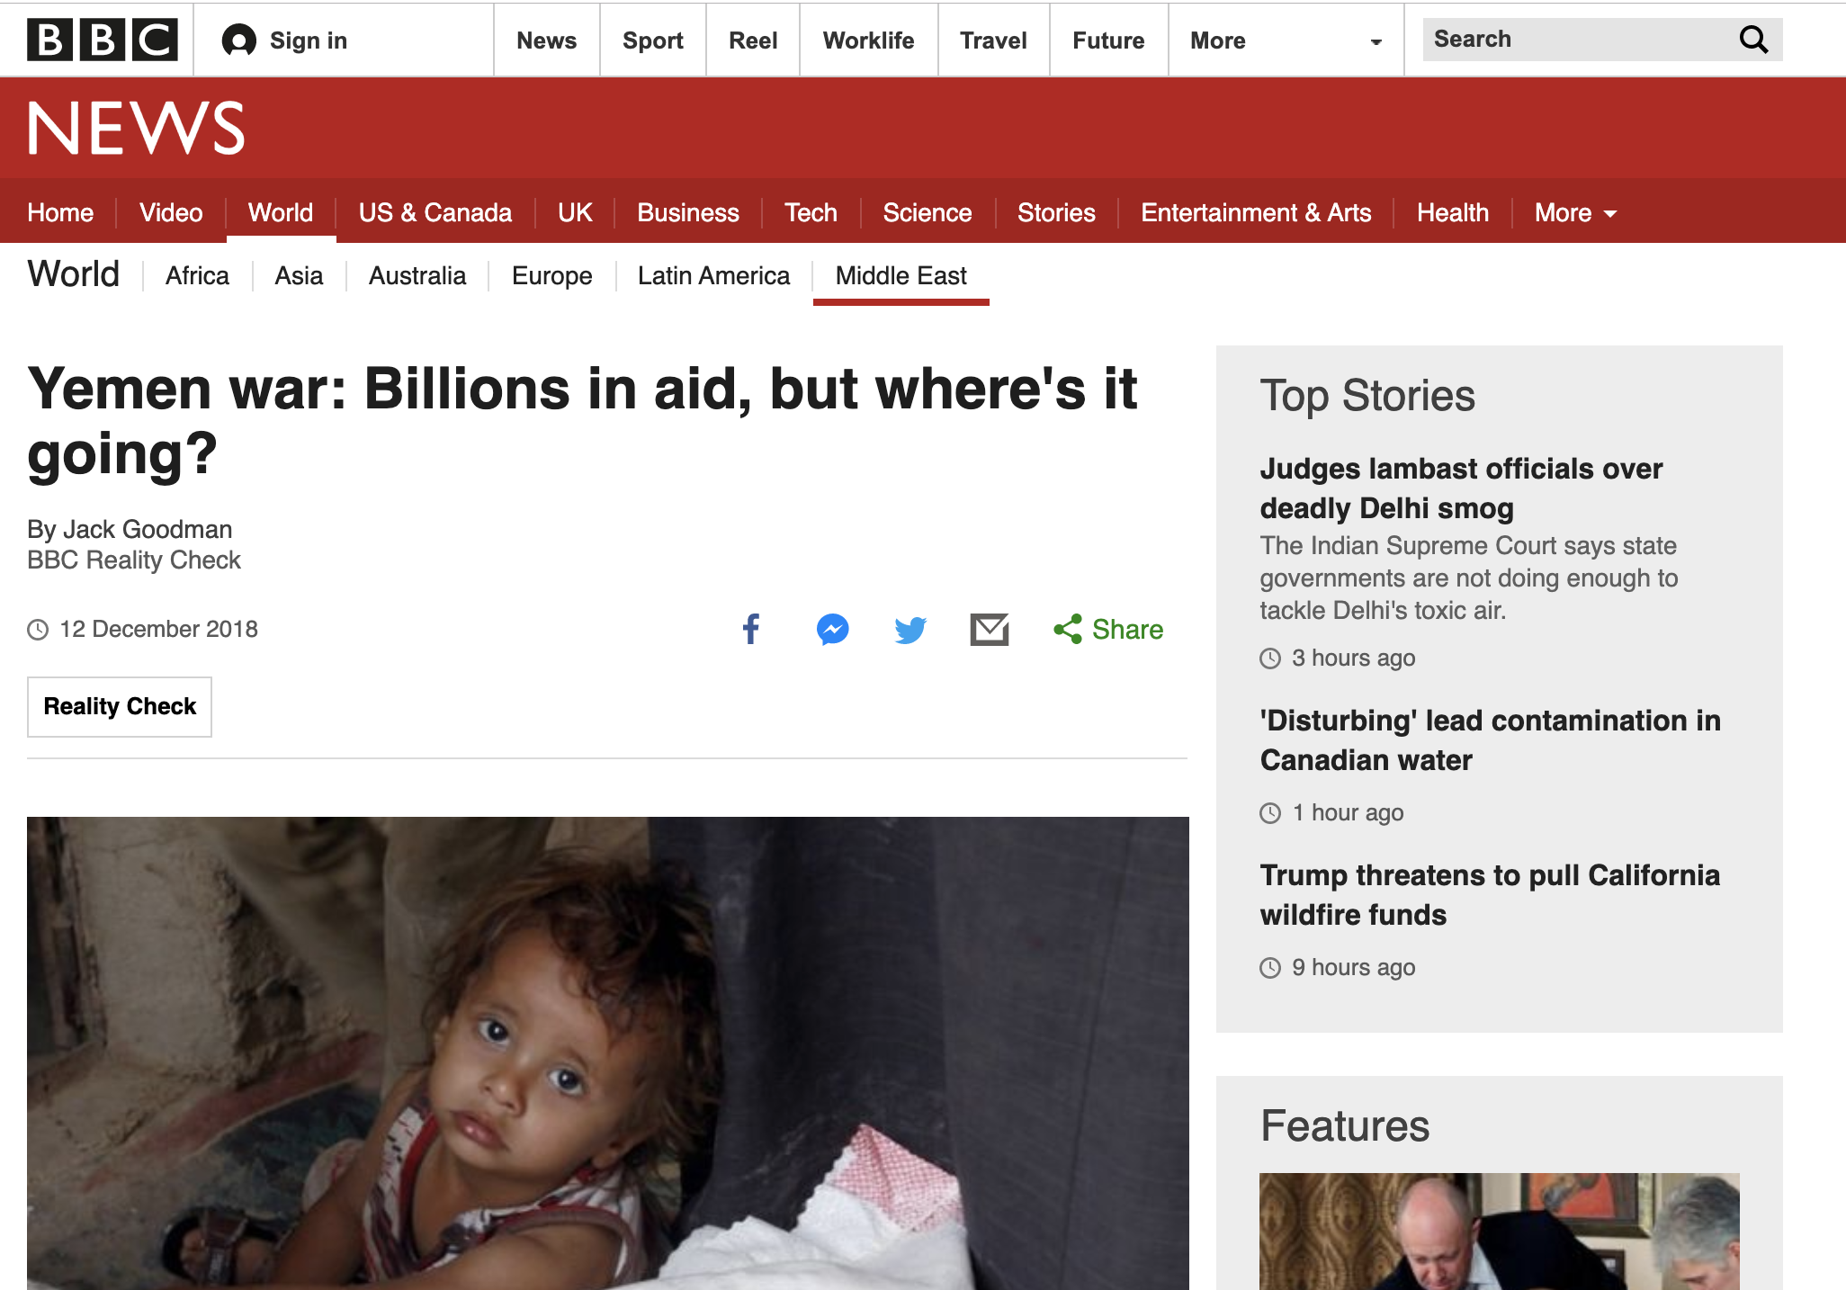
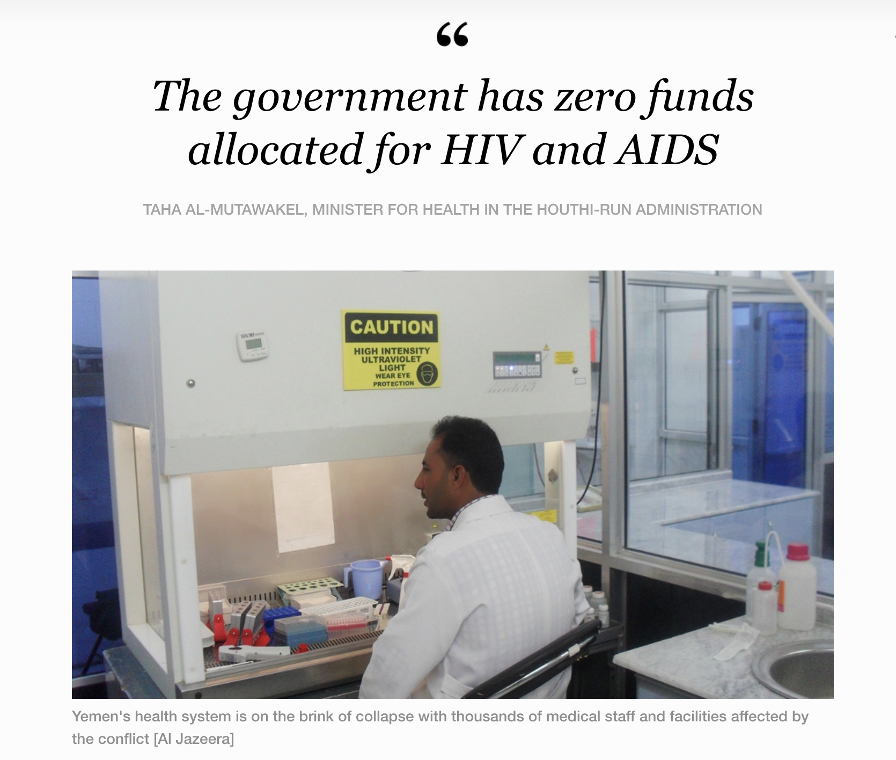
HEALTHCARE FINDINGS
Notes:
After further investigation we found that Yemen is currently on a civil war, which makes the data gathering process way harder.
There’s also a lot of suspicious that the money provided by the UN and other international organizations is not being spent on what was originally meant for.
This made us conclude that even though the data might come from an apparently reliable source (World Bank) we should always keep a critical sense.

Slide 21
CONCLUSIONS
ARAB PENINSULA ON SOCIO-ECONOMIC
ARAB PENINSULA ON HEALTHCARE
Notes:
Socio-Economic
We found a slight correlation between the countries population and surfaces and their respective GDP. PWC argued that this might be a favorable market condition.
Oil Industry, typical from that area is becoming less profitable, as other countries invest on renewable energy and perform better.
Healthcare
In certain countries there are ongoing conflicts that difficult the spread of contraceptive methods as well as the health awareness.
However the birth rates in given areas are declining due to financial crisis, in others, tradition and religion makes this indicator boost
Even though the data might come from apparently reliable sources, analysts should maintain a critical sense
Socio-Economic and Healthcare
Countries with the highest GDP have the lowest undernourishment.
Countries with the lowest GDP are showing lower rates of HIV, opposing to our intuition.
This re-enforces the idea that we should keep a critical sense when analyzing stuff and not to draw conclusions based on a single piece of dataset or information.
Finally, countries from the Arabian Peninsula seem to be doing better on socio-economic aspects than healthcare.

Slide 22
APPENDIX

Slide 23
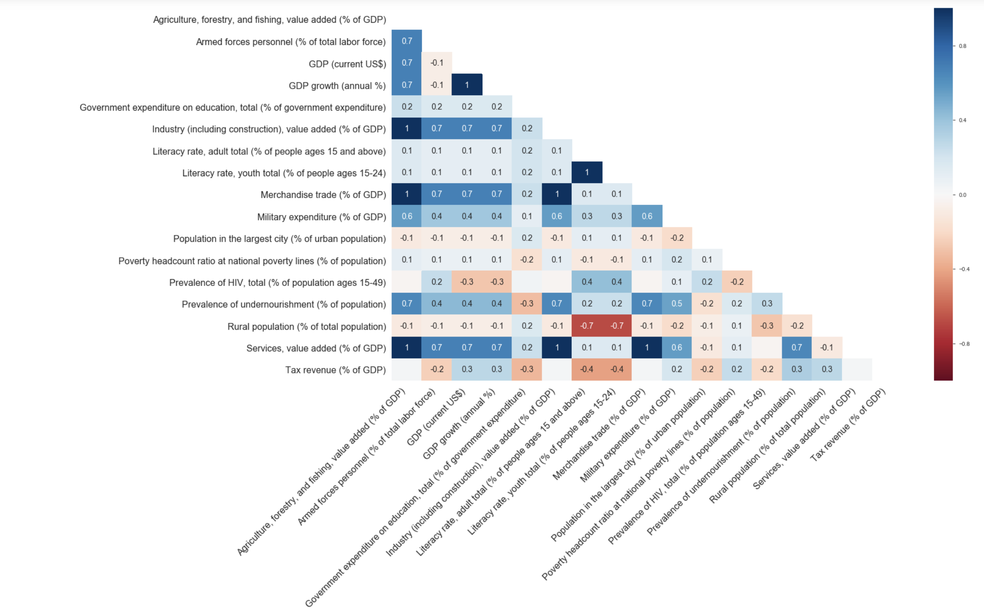
CORRELATION HEAT MAP
Notes:
What are the strongest correlation?
Use Shreyak’s correlation indicator (should or should not be there)

Slide 24
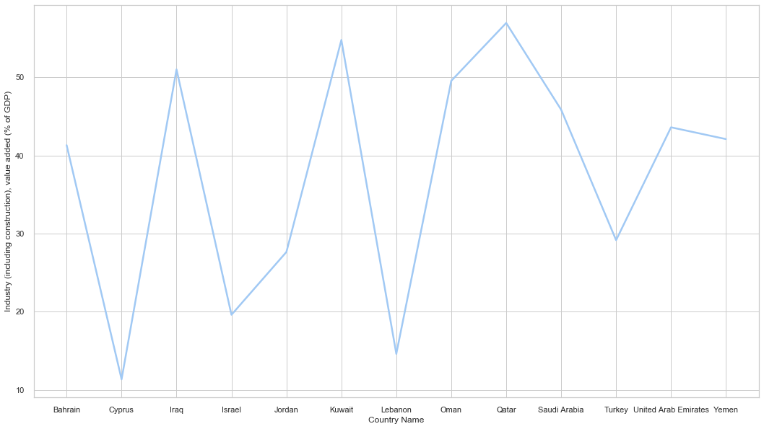
SOCIO-ECONOMIC FINDINGS
Kuwait
Qatar
Iraq
Oman
Notes:
Iraq, Kuwait, Oman, Qatar highest industry are countries known to have oil, which is commodity capable of significantly impacting the world economy.
Being oil as their major trade becoming so pricy and with a lot of demand, most of the times when a country has this goods to offer, this represents a huge part of the country’s economy.

Slide 25
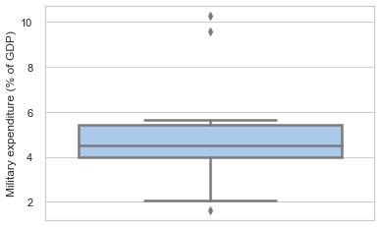
GOVERNMENT EXPENDITURE
Notes:
Saudi, Oman, Turkey in descending order
We used a couple of variables to check correlations bet any of them.
There does not seem to have any strong correlations with the mentioned variables.
Although there are negative correlations between life expect and prevalence of undernourishment and rural population

Slide 26
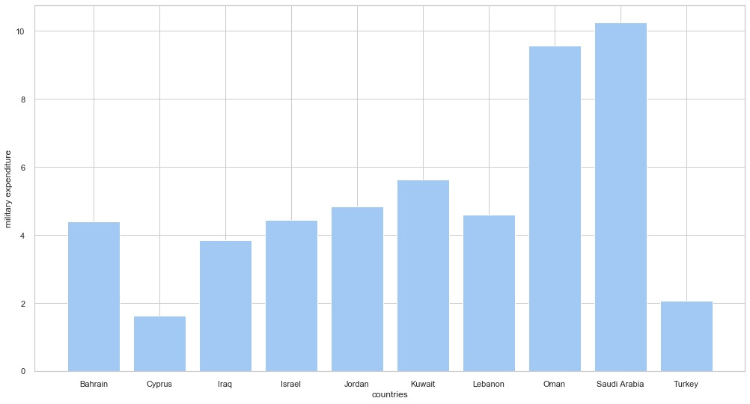
GOVERNMENT EXPENDITURE

Slide 27
References
http://www.atlasofurbanexpansion.org/cities/view/Sana
http://worldpopulationreview.com/countries/cyprus-population/
http://worldpopulationreview.com/countries/yemen-population/
https://blogs.lse.ac.uk/mec/2017/06/12/yemens-rural-population-ignored-in-an-already-forgotten-war/
https://data.worldbank.org/
https://www.bbc.com/news/magazine-25849945
https://www.ft.com/content/89bbcf7e-3380-11e9-bd3a-8b2a211d90d5
https://www.girlsnotbrides.org/child-marriage/iraq/
https://www.worldatlas.com/articles/what-are-the-biggest-industries-in-turkey.html
https://www.who.int
https://cyprus-mail.com/old/2018/11/09/cyprus-has-the-lowest-birth-rate-in-the-world/
https://fas.org/irp/agency/army/arabculture.pdf
https://tradingeconomics.com/turkey/gdp-growth
https://en.wikipedia.org/wiki/Economy_of_Turkey
https://www.saudiembassy.net/history
https://www.weforum.org/agenda/2017/03/worlds-biggest-economies-in-2017/
geoba.se/population.php?pc=world&type=028&year=2017&page=1
https://www.khaleejtimes.com/business/energy/uae-revises-petrol-prices-for-november-
https://deloitte.wsj.com/cio/2017/02/09/2017-oil-and-gas-industry-outlook/
https://www.unicef.org/press-releases/malnutrition-amongst-children-yemen-all-time-high-warns-unicef
http://www.emro.who.int/asd/country-activities/
https://www.bbc.com/news/world-middle-east-46469168
https://www.aljazeera.com/indepth/features/forgotten-living-hiv-war-ravaged-yemen-190112193247959.html

